Slide 1



Capstone Project Phase 1
Citation Prediction using GAN
Biran Fridman
Ilya Lev
Supervisor’s
Dr. Renata Avros
Prof. Zeev Volkovich

Slide 2

01
The Projects Goals
Objective:
Improve quality and relevance of scholarly articles by addressing irrelevant citations.
Develop an automated solution using GAN-based link prediction algorithm.
Streamline citation process for researchers, ensuring meaningful references.
Focus:
Utilize GAN’s to predict missing citations and identify irrelevance.
Construct citation graphs to establish relationships between articles.
Enhance research integrity with accurate and efficient citation evaluation.
The results:
Maintain research integrity by excluding irrelevant citations.
Access reliable information by reducing irrelevant references.
Save time and effort with automated citation relevance assessment.
Notes:
When we say "streamline" in the context of the citation process, we mean making it more efficient, simplified, and optimized. The goal is to eliminate unnecessary steps, reduce complexity, and provide researchers with a smoother and more straightforward process for including citations in their articles. By streamlining the citation process, researchers can save time and effort, focusing on including only those references that are relevant and contribute meaningfully to their work. This ensures that the references are purposeful, reliable, and add value to the research being conducted.

Slide 3
02
Need for the project
Why do we need to remove irrelevant citations from articles?
Do not contribute to the content of the article.
Undermine the integrity of the research.
Diminish the focus of the author's work.
Time wasting for readers that pursue irrelevant references.
Existing methods to combat this problem include manual screening, expert reviews, and algorithms, suffer from limitations such as subjectivity, time consumption, computational limitations, and insufficient accuracy.

Slide 4
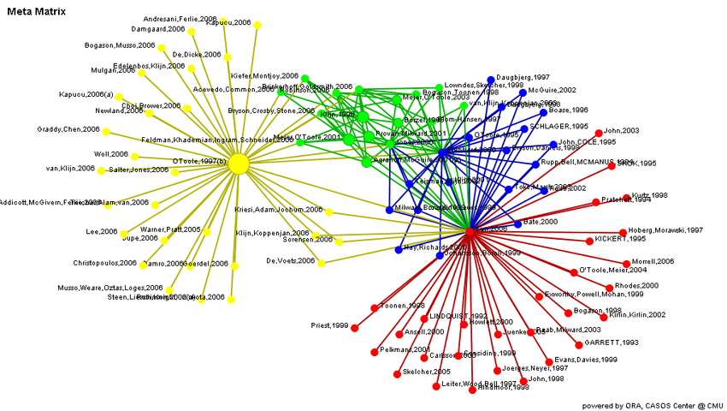
03
Complex Network Graph
A Directed network graph 𝐺 = (𝑉, 𝐸)
Vertex set marked as 𝑉 - Each vertex represents a data object (In our case an article).
Edge set marked as 𝐸 - Each edge represents a relationship between the
data objects (An article that references
another article).
𝑁(𝑉𝑐) – The direct neighbors of Vertex 𝑉𝑐.

Slide 5
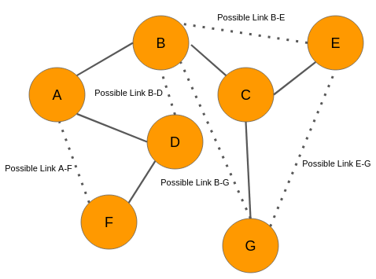
04
Link Prediction
Link Prediction refers to the task of predicting connections (links) between entities in a network.
In our project link predictions refers to predicting Citations between academic articles.
The importance of being able to accurately predict missing, future, bogus links in a network has opened a door for researchers to use graph modeling in many areas and advancing research in those topics by utilizing link prediction solutions.
Notes:
such as Social networks, Biological networks , Financial networks

Slide 6
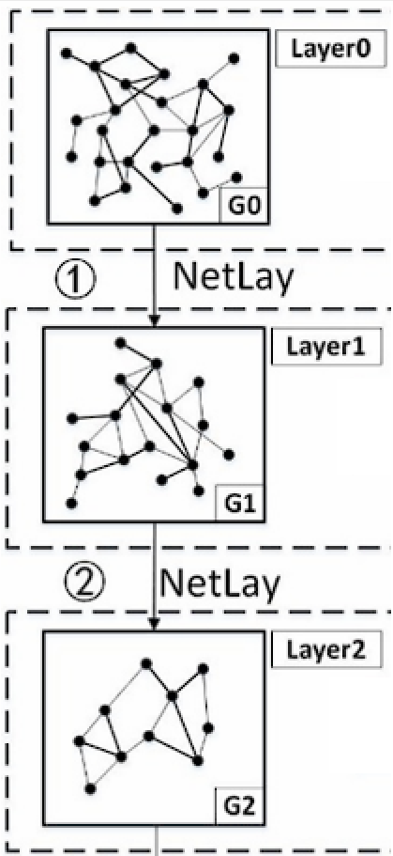
05
Hierarchical Processing of a network graph
Hierarchical Processing refers to the approach of analyzing and understanding the graph’s structure and information in a hierarchical or multi-level manner.
Involves breaking down the graph into different level or layers and analyzing each level to gain insight about the network.
Helps revel the complex organization and relationship within the network.
At each level of the hierarchy, various techniques are employed to extract meaningful information.
The goal is to understand the graph’s characteristics and the connectivity patterns by considering each layer.

Slide 7
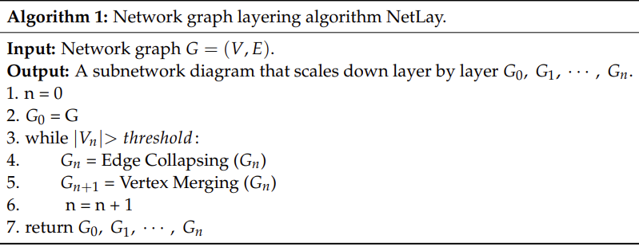
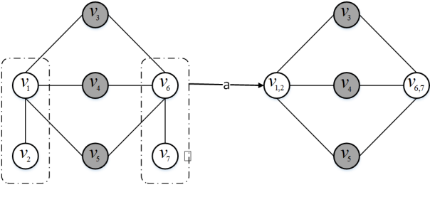
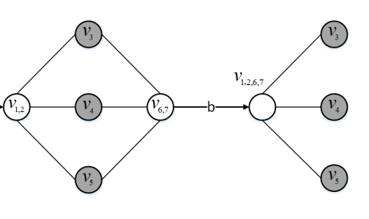
Network graph layering algorithm – Netlay
06
Edge Folding
Vertex Merging

Slide 8
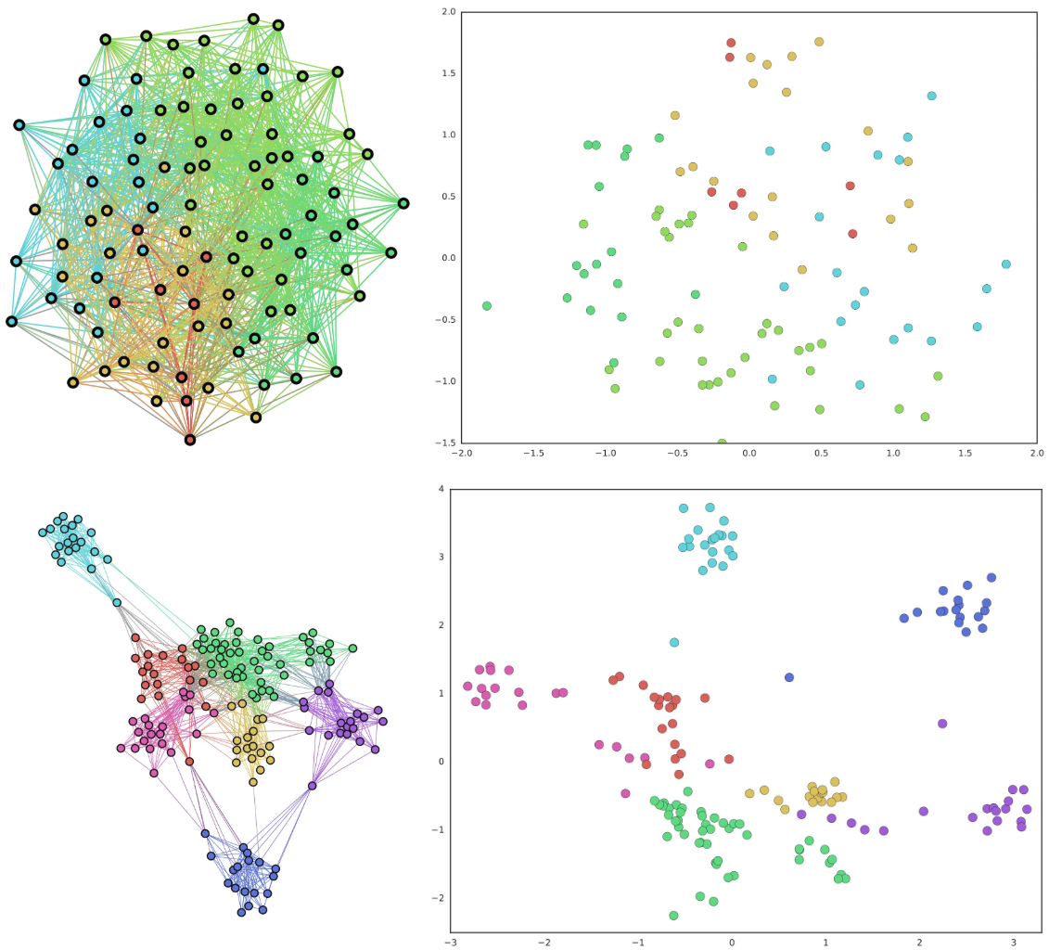
07
Node Embedding
The process of translating A network graph into a set of vectors while preserving the relationships and properties within the graph is named node embedding.
Node2Vec is the algorithm used in the project to create vector representations of nodes in a graph for machine learning applications.
(AI)

Slide 9
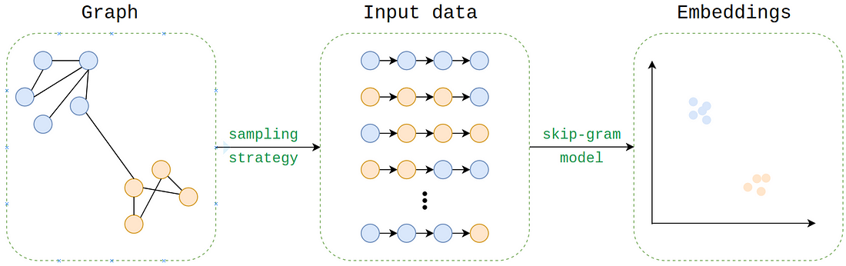
08
Node2Vec
Random Walk
A mathematical model used to describe a random process that involves moving through a network or graph, where each step is taken at random based on a set of probabilities.
Node2Vec Algorithm
Works by using random walks through the graph.
The algorithm treats the random walks like sentences in a text, where each node is treated as a word and a random walk is treated as a sentence.
By feeding these "sentences" into a skip-gram, traditional data-mining techniques can be used.

Slide 10
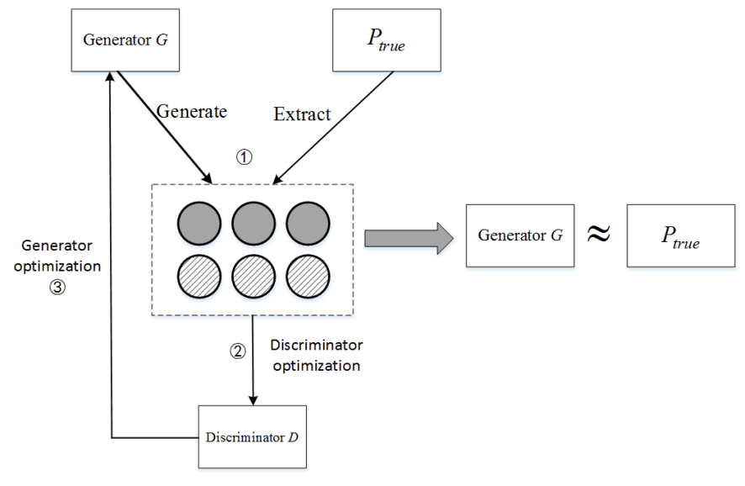
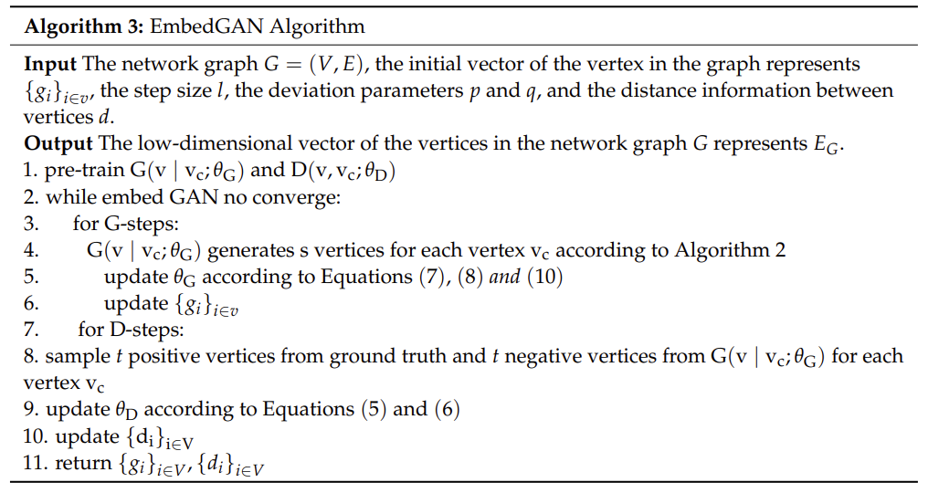
09
EmbedGAN Algorithm
Achieves low dimensional vector representation of the graph’s vertices.
Utilizes a generator and discriminator framework , generates and refines samples iteratively.

Slide 11
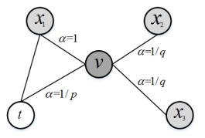
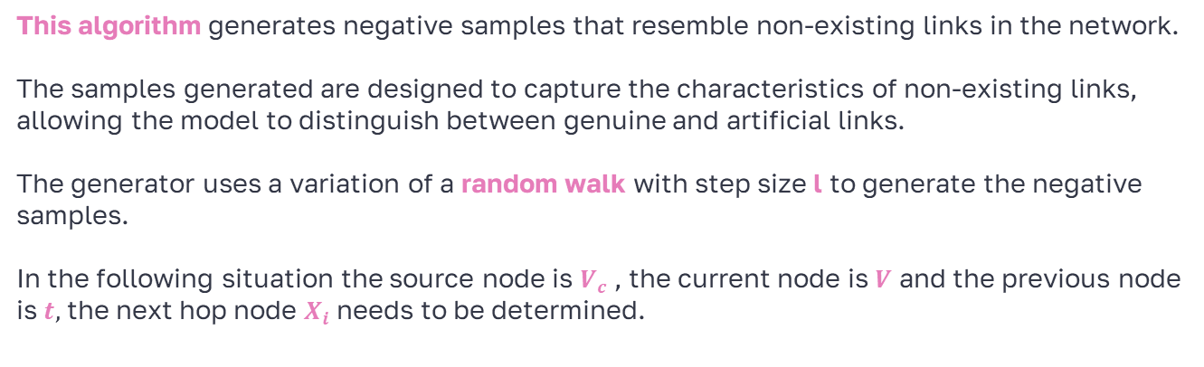
10
Generator Sampling Strategy
This algorithm generates negative samples that resemble non-existing links in the network.
The samples generated are designed to capture the characteristics of non-existing links, allowing the model to distinguish between genuine and artificial links.
The generator uses a variation of a random walk with step size l to generate the negative samples.
In the following situation the source node is $V_{c}$ , the current node is $V$ and the previous node is $t,$ the next hop node $X_{i}$ needs to be determined.

Slide 12
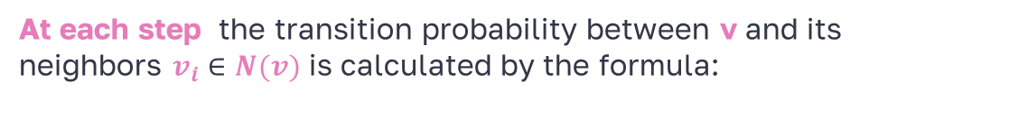
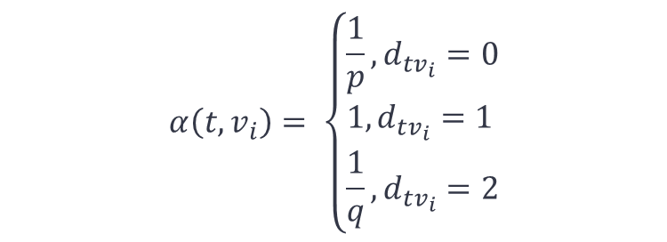
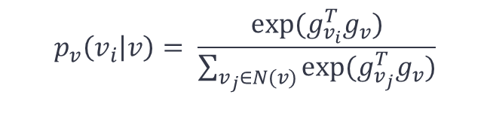
11
Generator Sampling Strategy
At each step the transition probability between v and its neighbors $v_{i}∈N(v)$ is calculated by the formula:
$$p_{v}\left(v_{i} | v\right)= \frac{exp⁡(g_{v_{i}}^{T}g_{v})}{\sum_{v_{j}∈N(v)}{exp⁡(g_{v_{j}}^{T}g_{v})}}$$
Then, the transition probability is weighted by the deviation coefficient $α$ of random walk:
$$α\left(t,v_{i}\right)= \left\{\begin{aligned}&\frac{1}{p},d_{tv_{i}}=0 \\ &1,d_{tv_{i}}=1 \\ &\frac{1}{q},d_{tv_{i}}=2\end{aligned}\right.$$
And the non – standard probability $w$($v_{i}\left|v\right)=p(v_{i}$ | v) * $α$(t | v) is obtained.

Slide 13
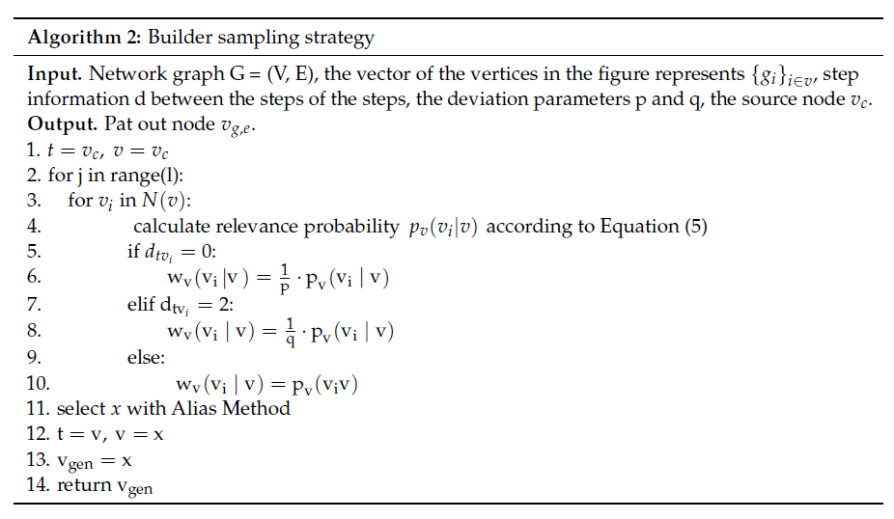
12
Generator Sampling Strategy

Slide 14
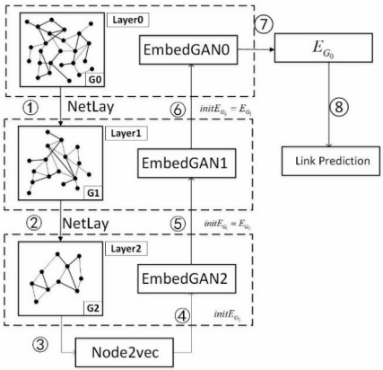
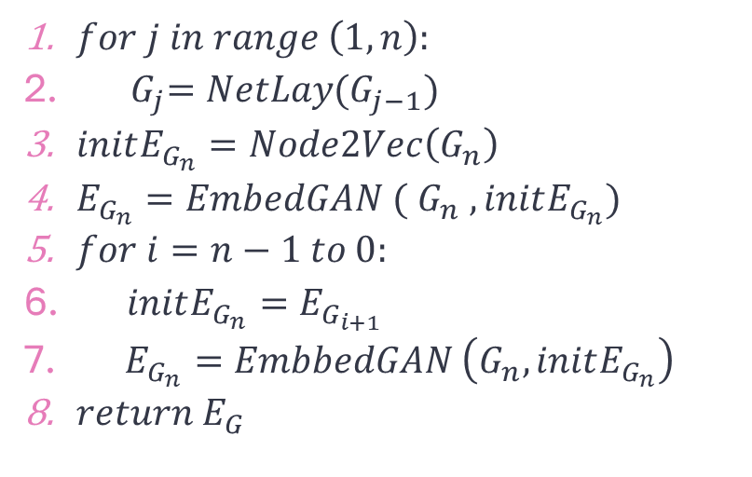
13
GAHNRL Algorithm
$for j in range \left(1,n\right):$
${ G}_{j}=NetLay(G_{j−1})$
$initE_{G_{n}}=Node2Vec\left(G_{n}\right)$
$E_{G_{n}}=EmbedGAN ($ $G_{n} , initE_{G_{n}})$
$for i=n−1 to 0:$
$initE_{G_{n}}=E_{G_{i+1}}$
$E_{G_{n}}=EmbbedGAN \left(G_{n},initE_{G_{n}}\right)$
$return E_{G}$

Slide 15
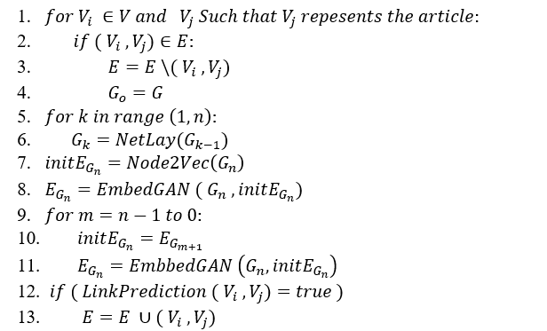
14
Our Solution

Slide 16
15
Validation
The selected approach for testing our algorithm is the following:
Data Preparation and Model Training:
Simple Split: Process the dataset by dividing it into two parts, 70-80% training and 20-30% testing.
Cross – Validation: Divide the dataset into “folds”, the model is trained and evaluated multiple times, each time using a different fold.
Prediction Generation:
Generate predictions for the presence or absence of a relevant and irrelevant citation.
The model will output a probability or a binary prediction for each citation instance in the testing set.

Slide 17
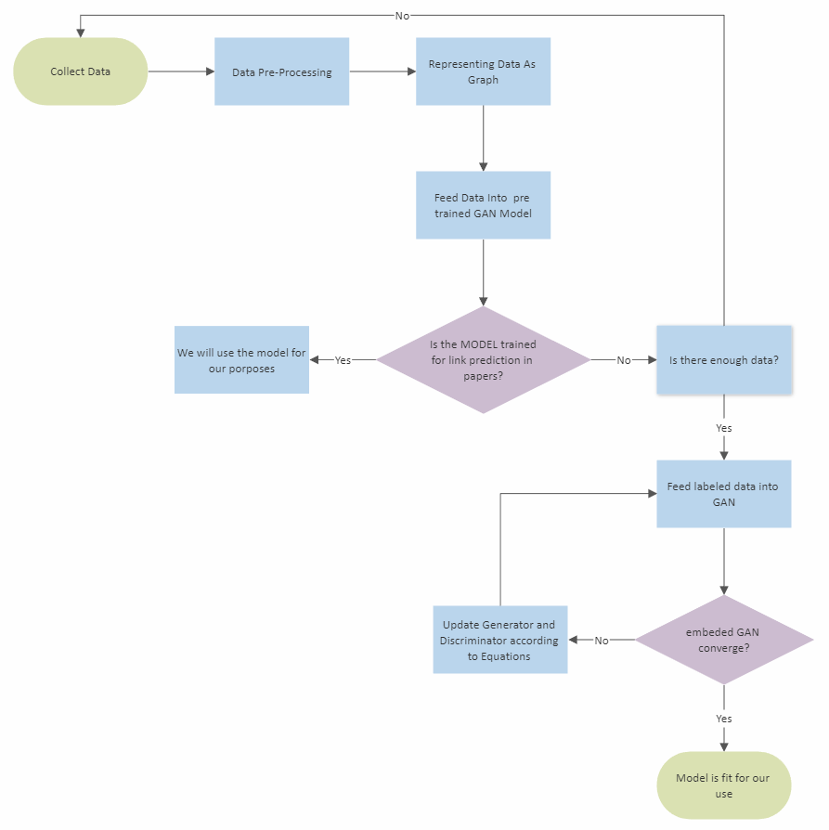
16
Data Collecting and processing

Slide 18
17
Evaluation
Evaluation Metrics:
Accuracy: How well the model predicts the presence or absence of the links.
Precision: Precision of the model in the identifying irrelevant citations correctly.
Recall (Sensitivity): The ability of the model to identify relevant citations in the testing set.
Above 80% accuracy and 70-80% precision and recall is considered a success.
Evaluation Process
Analyze the evaluation metrics to gain insights into the model's performance.
Based on those analysis fine-tune the model if necessary.
Repeat the training and testing process.
Finally, Summarize the results of the testing process in a comprehensive report.

Slide 19
18
The upcoming challenges
Dataset issues:
Finding suitable academic articles with citation information can be challenging.
Ensuring a comprehensive ,diverse and representative of different academic fields.
Scalability and efficiency:
Dealing with the computational complexity of the algorithm for large scale datasets.
Limited on hardware resources for training and perfecting the model.
Data preprocessing:
Cleaning and preprocessing the dataset to remove noise and inconsistencies.
Working through missing or incomplete data and formatting.
Lack of experience:
Limited expertise in link prediction using GANs and citation networks poses a challenge due to the unfamiliarity with the field, potentially impacting the project's progress and outcomes.

Slide 20
Thanks!
19
Any questions?

